Slide 1
You Sh[e|a]ll not pass!
Gentle Introduction to EDR Bypasses

Slide 2

beacon> whoami
Username: Riccardo Ancarani
Alias: @dottor_morte
Position: Principal Security Consultant @ WithSecure
Duties: Lead of Attack Detection Services

Slide 3

beacon> whoami
Username: Devid Lana
Alias: @Her0_it
Position: Senior Security Consultant @ Sorint.SEC
Duties: Leading Offensive Security Services

Slide 4
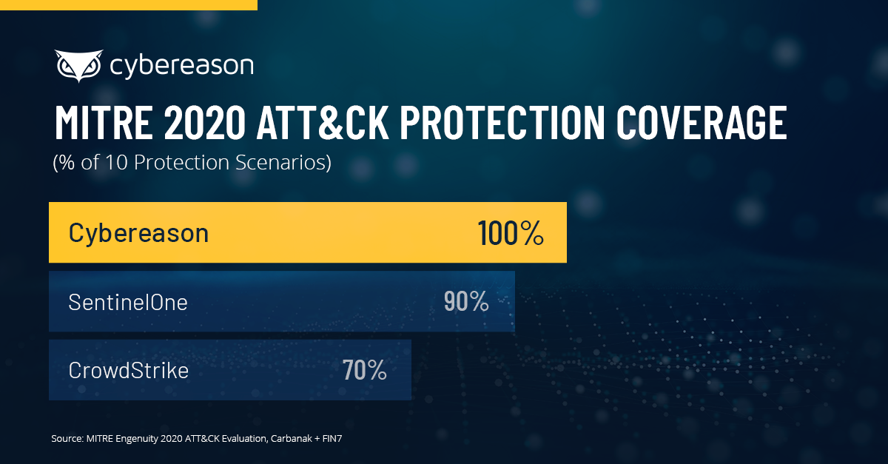

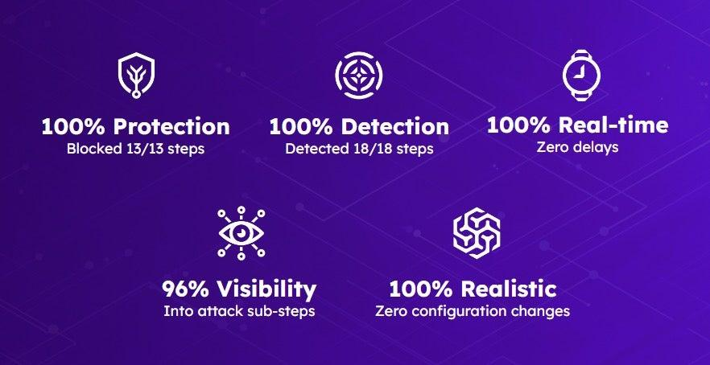
Introduction
The world of EDR is full of BS due to marketing
Very few understand exactly their purpose and how to maximise their value
Somehow breaches still happen!
Notes:
sold as a silver bullet against attacks
MITRE evals don’t help too much to inform customers

Slide 5
Introduction
Endpoint -> Where it gets deployed
Detection -> Detect upon attacker’s actions
Response -> Has response capabilities to remediate or contain
Collects telemetry
Aggregates into alerts in the backend
Provides the tools to respond to a threat

Slide 6
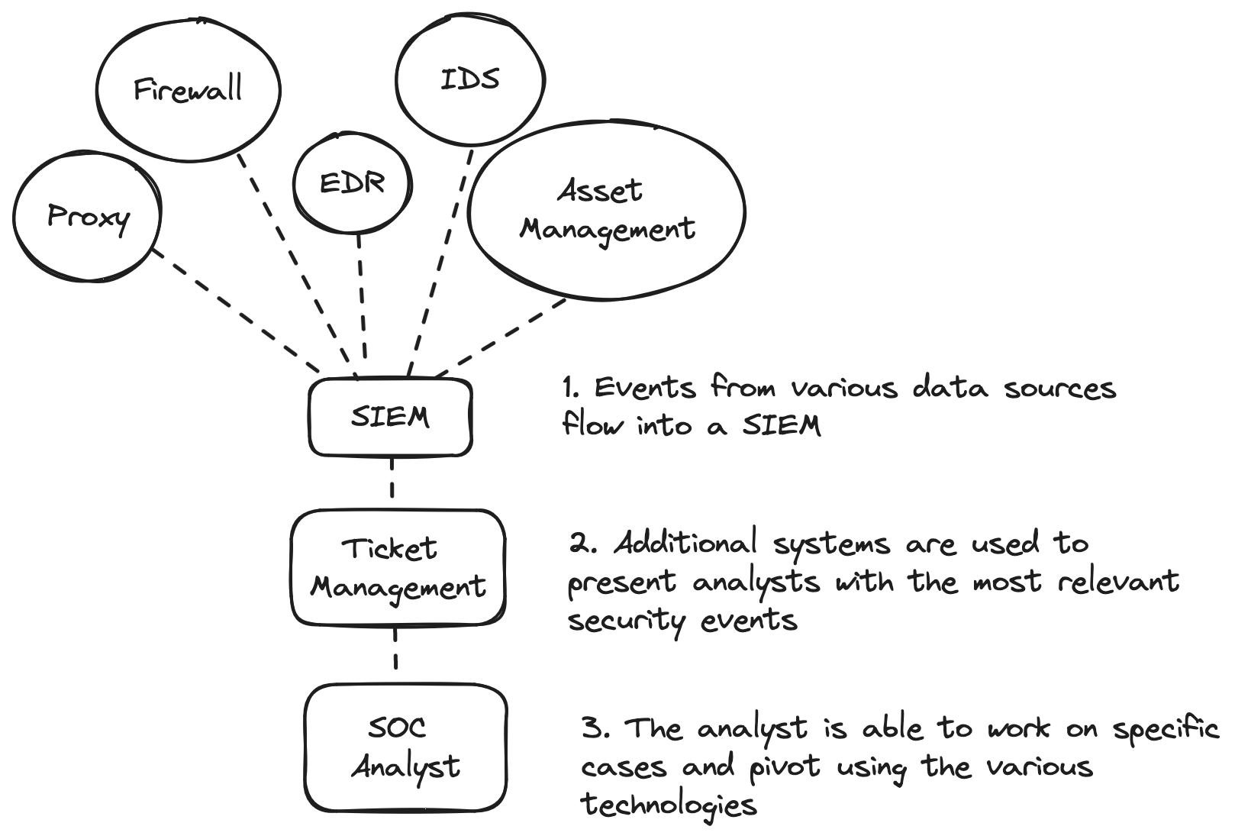
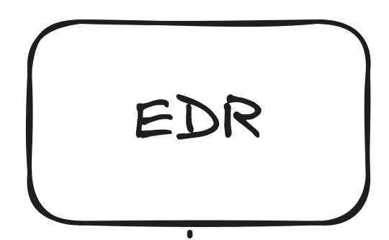
Lab Setup
IMAGINATION
REALITY
Notes:
Even if we evade an EDR, there is a whole stack of technologies that defenders can use to identify bad behaviours

Slide 7
Lab Setup
Elastic Defend Cloud, wealth of open source resources
Isolated Environment
Suggested to request trial for other products, TAs are already doing it!
Elastic 14 days trial

Slide 8
Metrics
TELEMETRY
Can you search for a specific event within your logs?
User X running notepad.exe
DETECTION
Aggregation of data coming from one of more telemetry sources to identify malicious activity
PREVENTION
Stopping the attack. E.g. Killing malicious processes.
INVESTIGATION
If a host produces enough alerts to go over a certain threshold, a human analyst will review this
Not every alert will generate an investigation
Notes:
Let’s discuss some metrics that will help us evaluate how an EDR product performs. Telemetry is merely the presence of data generated by a sensor, such as process creation events. Detection is the ability to aggregate telemetry from one or more sources to capture a malicious behaviour. Prevention is the ability to stop a specific action. Lastly, we should also make the distinction between automatic detection and investigation. An alert does not mean that a human will look at it necessarily, most of the times investigations will be triggered after a HIGH or a CRITICAL alert or if a certain threshold is reached. Even if you do not trigger alerts, hunters might still be able to spot your activities if sufficient telemetry is present. Even if you trigger an alert, it does not mean that the entire attack chain is “ruined” because after all, a human analyst will need to decide if the alert is a false positive or not.

Slide 9
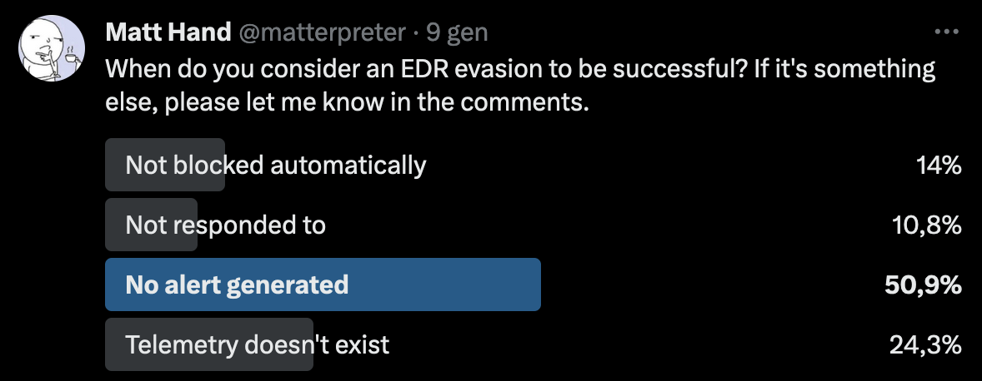
Bypass/Evasion
Many people simply use the evasion term
No formal definition
Bypass what? No detection? No ticket raised to the SOC? No telemetry? No disruption in the operation?
People are confused

Slide 10
Bypass/Evasion
In our view, bypass means that no alerts are generated, either from out of the box detection or custom ones that clients might have configured.
It’s just an opinion, but the rest of the talk will assume that bypass has that meaning.
For a real life intrusion, you will deal with People, Processes and Technologies:
Even if an alert is generated, doesn’t mean that an actionable ticket will be opened
Even if only telemetry is present, a forensic/IR analyst might be able to track our actions post-mortem or during an active hunt
No Alerts == More chances of success
Notes:
Not every alert will create an actionable ticket. Not every ticker will trigger a response action. If you generate alerts, the more likely that an investigation will happen as opposed to if you do not trigger any automatic detection rule.

Slide 11
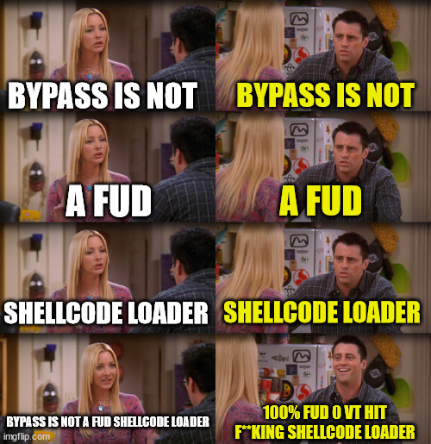
Bypass
Notes:
One thing that we should also clarify is that in most cases when we see people talking about EDR bypasses, they mostly show shellcode loaders that deploy a C2 agent. Whilst that is definitely part of the equation, we feel that it’s only a small fraction of what it means to operate in an environment with an EDR.
Specifically, detections are implemented across the entire attack chain and we should try not to generate alerts at each step of the attack lifecycle. You need to apply these concepts to ALL the actions you take during an engagement!

Slide 12
Evasion
PERCEPTUAL BYPASS:
Product: sensor doesn’t have the visibility to see activity
CONFIGURATION BYPASS:
End-User: Telemetry available but not being collected
LOGICAL BYPASS:
Attacker evades the analytical logic implemented by a detection ​CLASSIFICATION BYPASS:
Inability to gather the relevant information to classify an alert​
Source: SpecterOps - Evadere Classifications

Slide 13
Perceptual Bypass
Lack of the sensor’s capabilities to collect certain types of events.
Can be due to design reasons or technical limitations
Hypothesis: We want to establish persistence on a compromised box. Naturally, we want to maximise our chances of success in terms of avoiding being detected. The hypothesis is “an attack will be harder to detect where telemetry is lacking”
It’s not possible to detect what it cannot be seen.

Slide 14
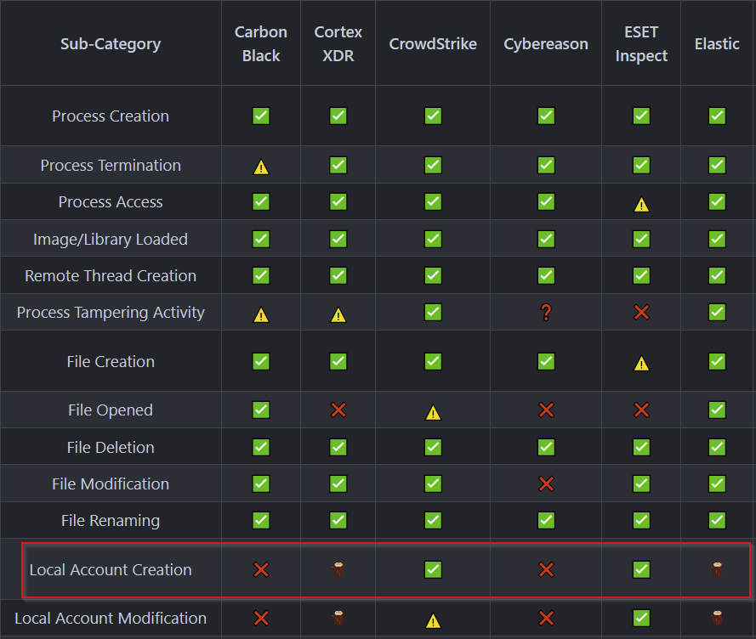
Perceptual Bypass
The EDR Telemetry project can give us some insights on the telemetry collected by the product we are facing.
In this case we see that user account creation is not collected natively, therefore making it a suitable candidate for establishing persistence:
Notes:
Not only referred to endpoint specific telemetry, but can look for out of date os, weird Linux systems and so on to find blind spots

Slide 15
Perceptual Bypass
Let’s test this! Pivoting to the MITRE ATT&CK page to get information about the attack:
T1136.001 - Create Account: Local Account
Naively, we can start our testing using with the classic net.exe technique:
Invoke-AtomicTest T1136.001 -TestNumbers 4

Slide 16
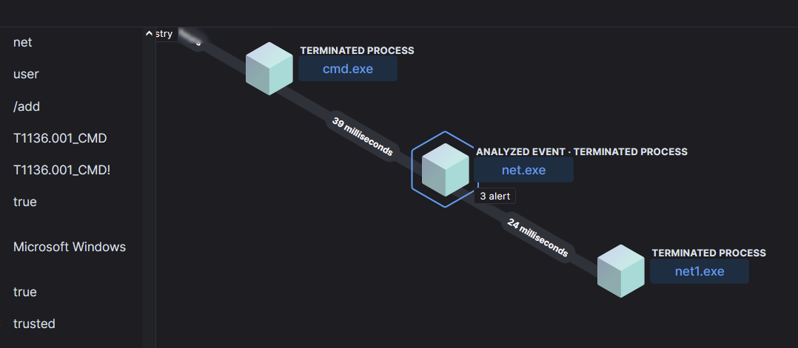
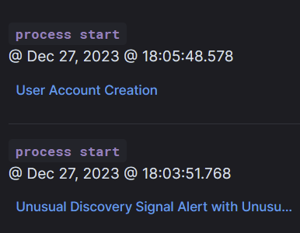
Perceptual Bypass
We can see that elastic can easily detect this.
CROWD: How come? We just said that it does not have telemetry for this! Are you lying to us???

Slide 17
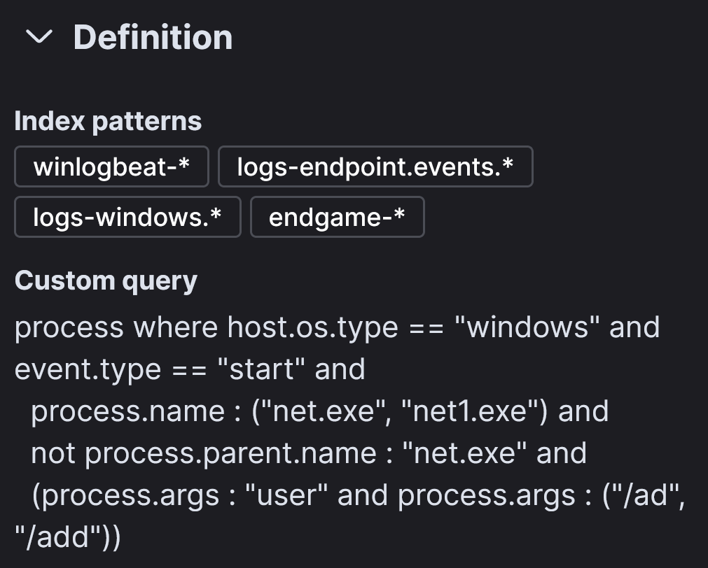
Perceptual Bypass
Looking at the detection rule that triggered, we can see that it relied on process creation events to detect the creation of a new user.
But is it the only way to create a user?
Notes:
This was not shown before as the approach should be applicable with closed source projects as well

Slide 18
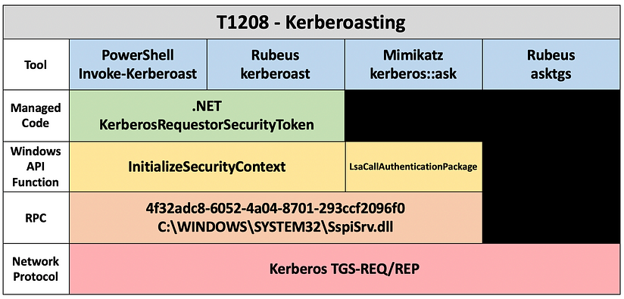
Perceptual Bypass
To understand that, we will leverage the Capability Abstraction framework by SpecterOps.
What the framework tells us is that each capability ultimately has a “base condition” that should be met to perform it.
Notes:
The question we should ask is: what is the base condition for a user to be added to a system?

Slide 19
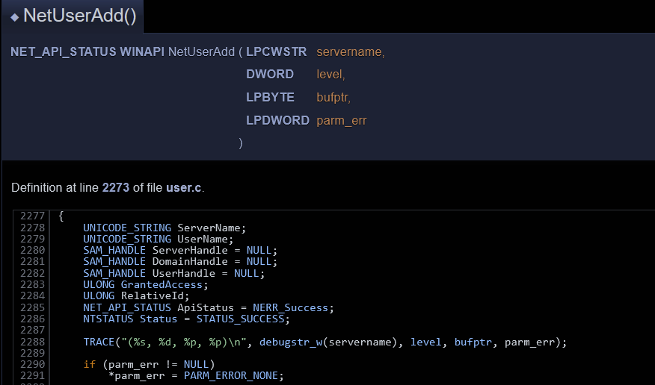

Perceptual Bypass
Let’s analyse net.exe/net1.exe to see how a user is added to the local system.
We can see that trough reversing, that the net1.exe utility uses the WinAPI NetUserAdd, we can then pivot trough ReactOs to see how it is implemented in details.

Slide 20
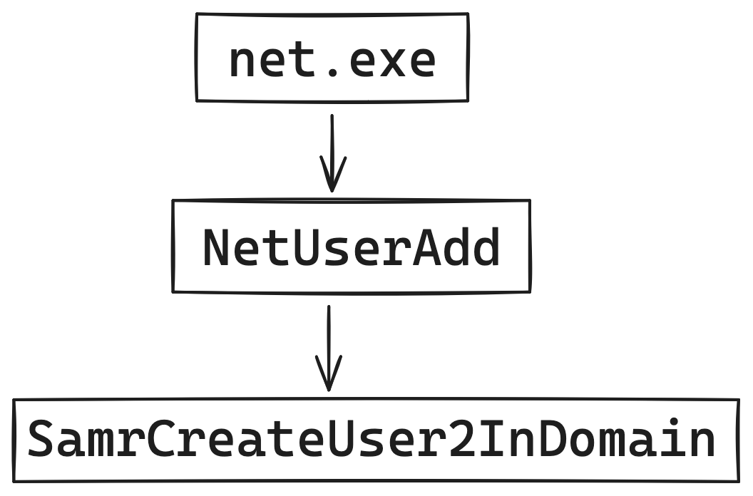
Perceptual Bypass

Slide 21
Perceptual Bypass
This means that if we somehow add a user using the lowest protocol in the chain, we might have better chances of evading that detection. Let’s try with rpcclient and leveraging the SAMR protocol directly:
This time, no detections from Elastic!
No telemetry = No detections
rpcclient -U "administrator%1qazxsw2.." 192.168.182.163 -c "createdomuser lowpriv3"

Slide 22
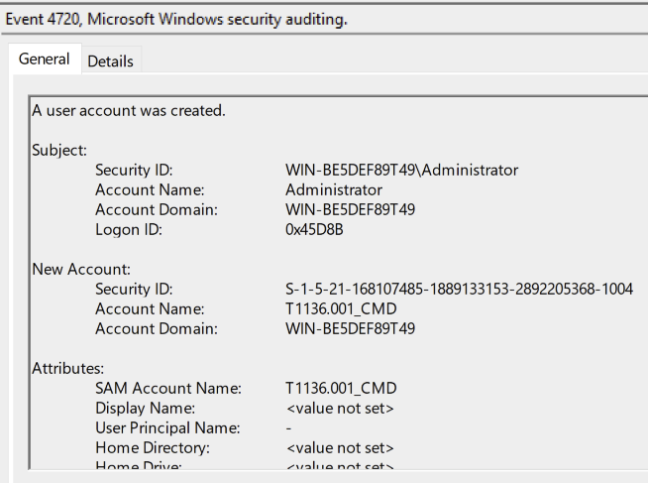
Perceptual Bypass
Not all the hope is lost, Windows provides built in telemetry that only needs to be enabled using the appropriate audit policies. This will generate events in the eventlog that can then be collected and forwarded to a SIEM:
auditpol /set /subcategory:"User Account Management" /success:enable

Slide 23
Perceptual Bypass
EDRs are not a silver bullet, they require extensive tuning and testing to meet a company’s security goals.
Also, please do not rely on MITRE ATT&CK IDs for coverage!
Notes:
Atomic red team test would have resulted in a positive detection, but coverage of the technique is not comprehensive

Slide 24
Logical Bypass
A logical bypass aims at exploiting a flaw in the implementation logic of a detection rule.
Let’s see an example with Scheduled Task by a Low Reputation Process

Slide 25
Logical Bypass Task Scheduler
Scheduled Task by a Low Reputation Process
sequence with maxspan=5m
[process where event.action == "start" and
(process.Ext.relative_file_creation_time <= 1800 or process.Ext.relative_file_name_modify_time <= 1800) and
(process.code_signature.trusted == false or process.code_signature.exists == false) and
not process.code_signature.status : "errorCode_endpoint*"] by process.entity_id
[file where event.action : "creation" and process.name : "svchost.exe" and
file.path : ("?:\\Windows\\Tasks\\*", "?:\\Windows\\System32\\Tasks\\*")] by Effective_process.entity_id
During the detection engineering process, the analyst identified the following base condition: If a scheduled task is created, then the following file creation event will also be present.

Slide 26

Logical Bypass Task Scheduler
The logic implemented by the analyst presents a flaw. In fact, the previously identified base condition for task creation is not correct.
This means that tasks can be deployed without creating files in C:\windows\tasks.
Our in-depth research showed which events are - in our view - a comprehensive base condition.

Slide 27
Configuration Bypass
Sensor not configured to capture certain events
On legacy systems some capabilities might not be available
EDRs are not plug and play, they do require a certain amount of configuration and tuning.
Some features might be turned off due to mistakes or inability of the SOC to triage certain types of events.
Whitelisted folders?
TimeException - conceptually shows how to identify whitelisted folders from a black box perspective

Slide 28
Classification Bypass
Classification bypasses exploit the inability of a product to determine if an event is malicious or not, despite being able to collect it. This usually stems from an event being so common that - in isolation - cannot be used alone to determine whether it’s bening or not.
Often implemented as filtering for events to lower the false positive rates.
Let’s take this example:
Elastic rule for unusual Windows native process performing LDAP activity

Slide 29
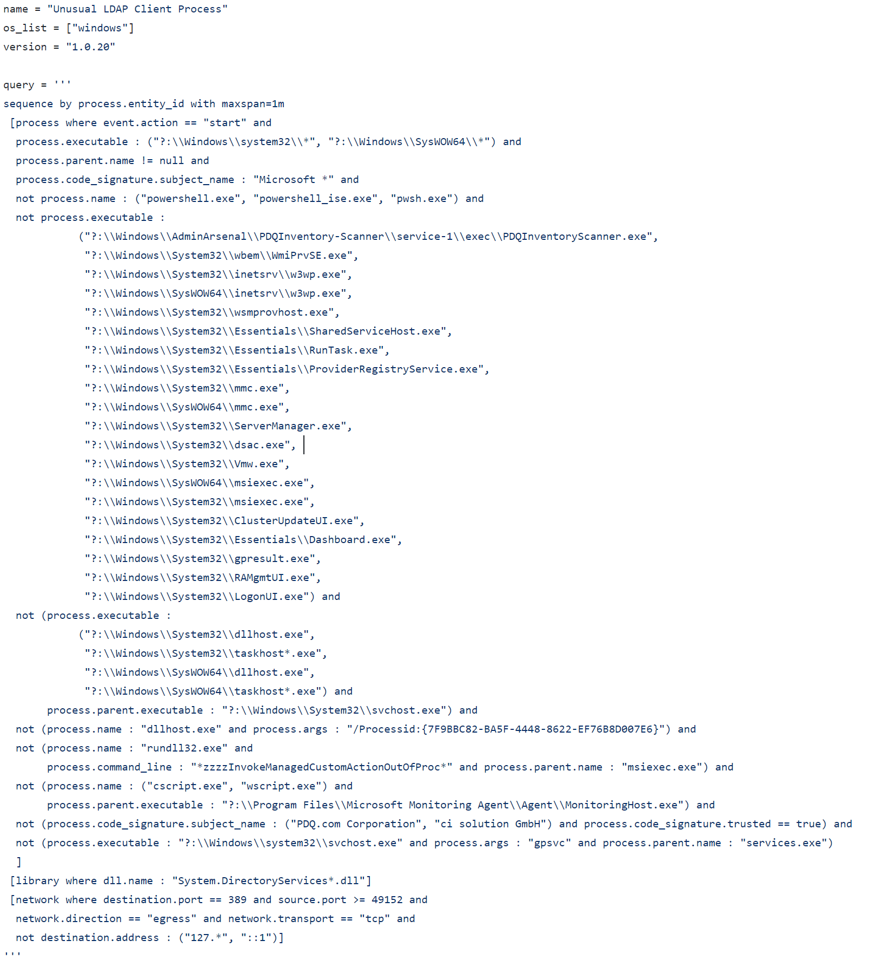
Classification Bypass LDAP Activity
In this scenario, we can circumvent the rule by identifying its potential weaknesses
perform the activity in the context of a process that is NOT included under scrutiny
perform the activity without LOADING the System.DirectoryServices*.dll (probably for .NET post-exploitation binaries in fork-n-run)

Slide 30
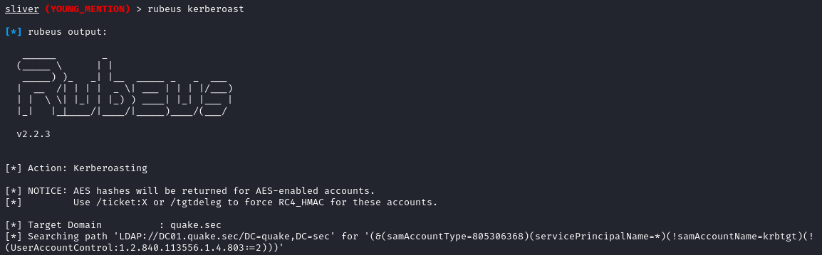
Classification Bypass LDAP Activity
Triggering the aforementioned rule is fairly easy.
We will use Sliver as C2 Framework
We will execute the builtin Rubeus directly from the C2
This is actually enough to cause some bells to ring

Slide 31
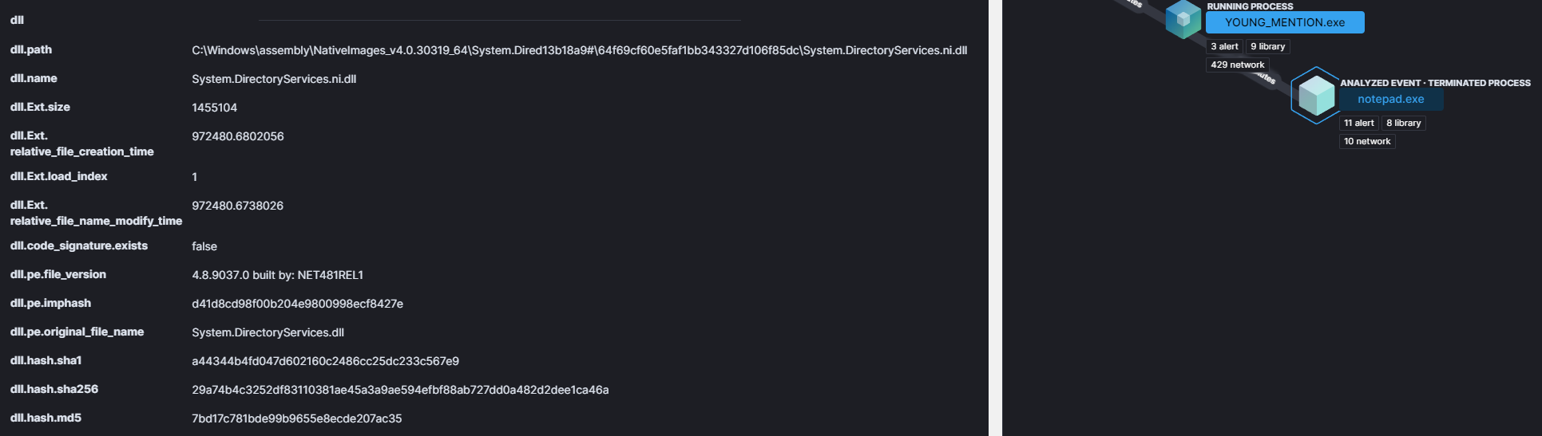
Classification Bypass LDAP Activity
Executing Rubeus from the C2 will spawn a new process (default notepad.exe), inject code into it, and finally start the execution. ( fork-n-run technique)

Slide 32
Classification Bypass LDAP Activity
A quick win would be just remain in the context of the current process, almost zero effort.
Problems:
Process observed for the first time
Suspicious process behaviour doing both http beacoming and executing LDAP queries
rubeus -i kerberoast /nowrap

Slide 33
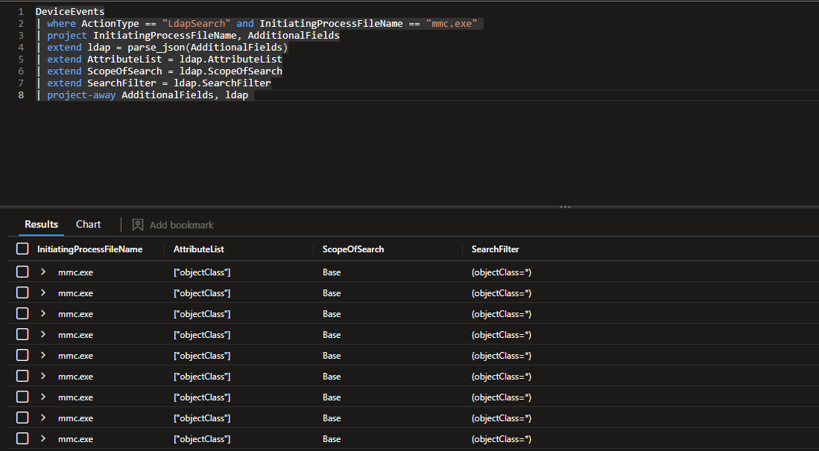
Classification Bypass LDAP Activity
But.. are we really blending in?

Slide 34
Classification Bypass LDAP Activity
choosing a process that normally executes ldap queries allow us to bypass the specific rule
obviously fork-n-run it’s not the best choice opsec-wise and there are better alternatives
execute-assembly -p mmc.exe rubeus kerberoast

Slide 35
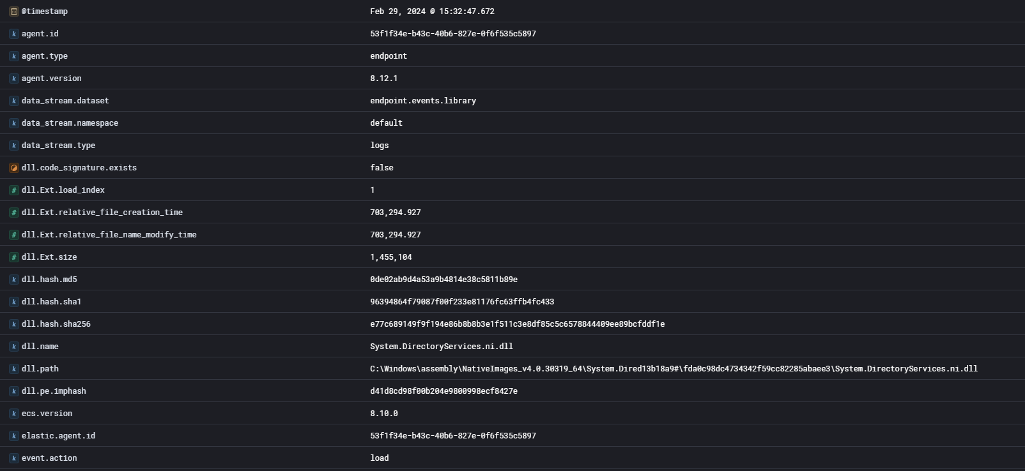
Classification Bypass LDAP Activity
Even though there are no alerts, telemetry is still generated and accessible, which might be useful for custom detection engineering or active threat hunting

Slide 36
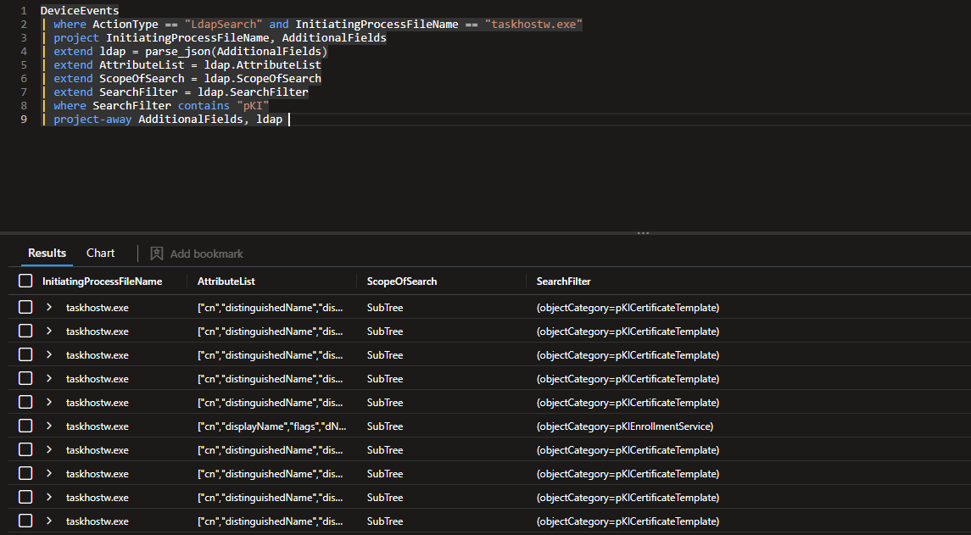
Classification Bypass LDAP Activity
Picking a process that commonly performs LDAP operation is a good start, but we should strive to “climb” the pyramid of pain in a somewhat twisted way and pick processes that mimic the exact procedure we want to perform.
Example: I want to perform PKI reconnaissance and possibly exploitation. What target process should I move to?

Slide 37
Classification Bypass LDAP Activity
Is this really OPSEC safe?
It depends, EDRs are complex products but still better than not taking precautions.
Note that this process was fairly straightforward since we could read Elastic’s detection rules, however the principles can be applied to black box scenarios where this wealth of information is not available to the intruder.

Slide 38
Tampering
If you can’t evade defences, turn them off
If you can’t turn them off, compromise their ability to report alerts
Product tampering usually requires administrative access to a host as you’d need to introduce changes to the state of the system
Sensor tampering exists in user-land, ETW bypasses, API Unhook and so on
Resources: A story about tampering EDRs , Attacking an EDR

Slide 39
Lack of Response
Even if you trigger an alert, it might be that the analyst that is triaging makes some mistakes:
Incorrectly classify an alert as a false positive, due to lack of skills/preparation
Incorrectly applies response procedures that are either not sufficient to eradicate the threat or tip off the attackers too soon during the attack chain.
🤷🤷🤷
Notes:
IRL example: beaconing to azure CDN from Teams process, alert of CobaltStrike by MDE, classified as false positive by MS SOC.

Slide 40
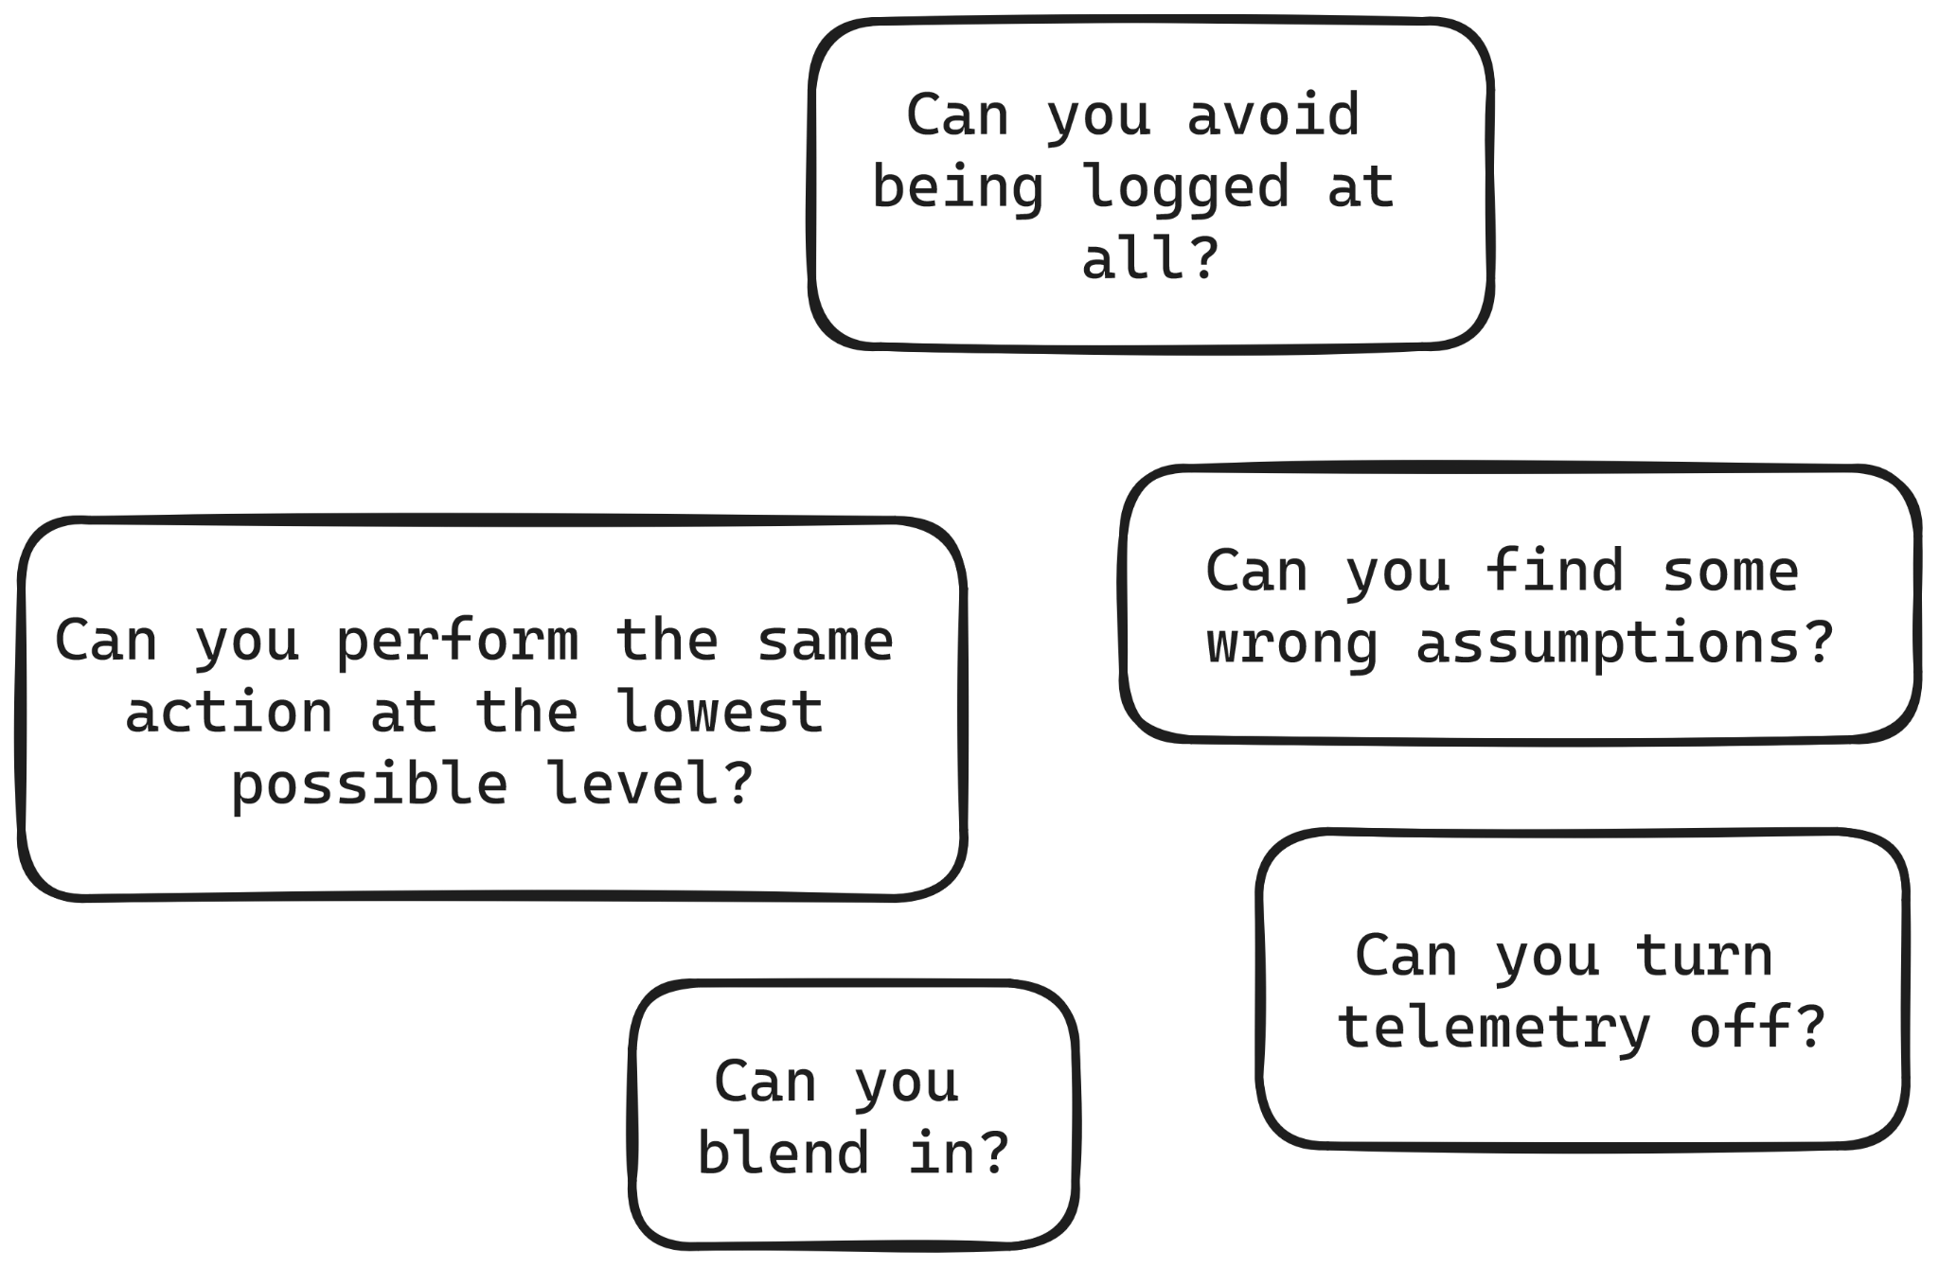
Final Considerations
Notes:
IRL example: beaconing to azure CDN from Teams process, alert of CobaltStrike by MDE, classified as false positive by MS SOC.

Slide 41
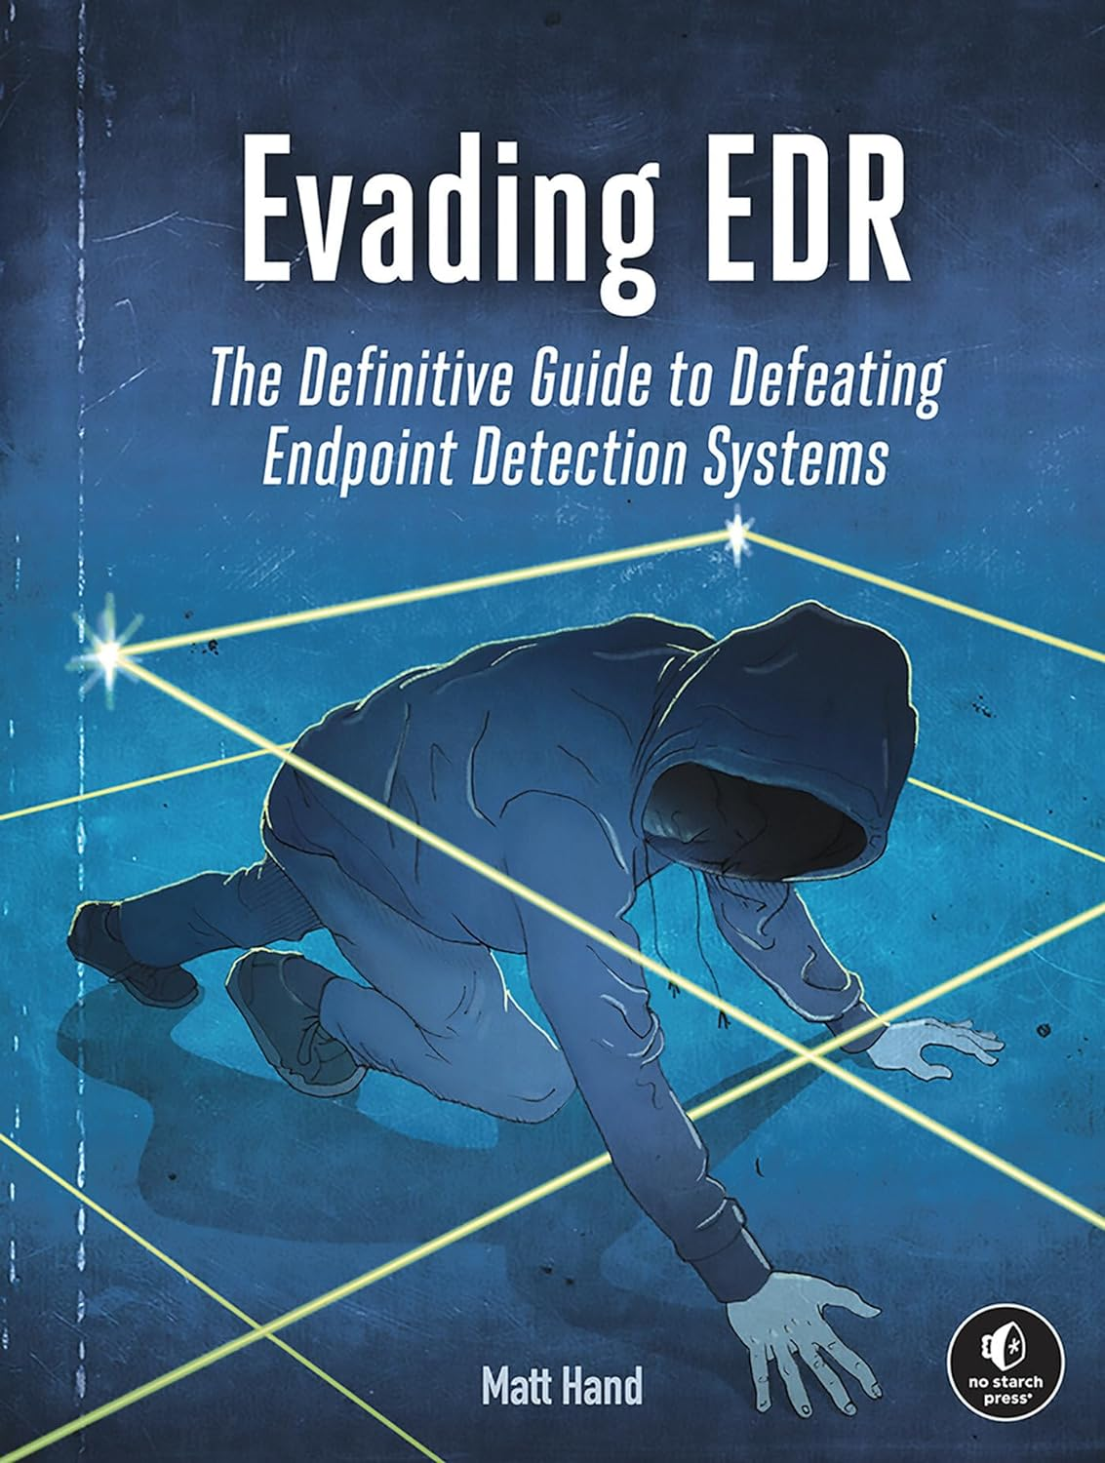
Resources
SpecterOps - Capability Abstraction
SpecterOps - Evadere - Classifications
A story about tampering EDRs
Attacking an EDR

Slide 42
Questions?

